Slide 1


Introduction to IDEs and Java
This presentation introduces Integrated Development Environments (IDEs) and Java. We will explore the benefits of using IDEs, popular examples, and key features. Additionally, we will delve into Java's core components, concepts, and advantages.
by Muhammad Qaiser Bashir

Slide 2

What is an IDE?
Definition
Key Components
Goal
An Integrated Development Environment (IDE) provides comprehensive facilities to computer programmers for software development.
An IDE combines a source code editor, build automation tools, and a debugger into a single application.
IDEs aim to increase developer productivity through a unified interface.

Slide 3
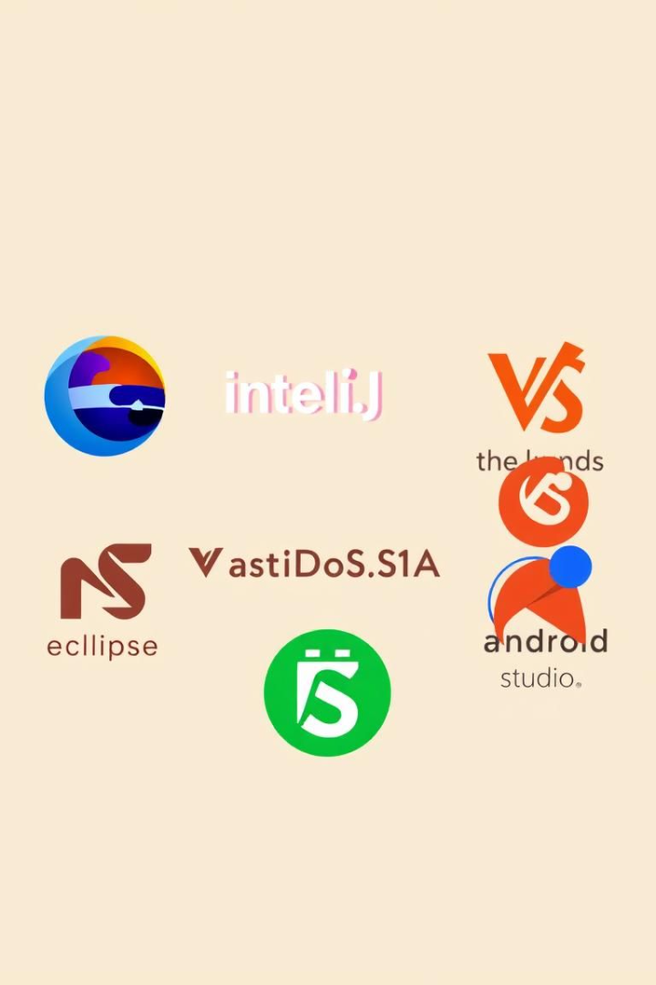




Popular IDE Examples
Eclipse
IntelliJ IDEA
Visual Studio
Open-source, extensible, supports multiple languages.
Commercial, productivity-focused with smart code completion.
Microsoft's IDE, supports C#, Python, JavaScript, and more.
NetBeans
Open-source, supports Java SE/EE, HTML5, PHP, C/C++.

Slide 4





Key Features of IDEs
Code Completion (IntelliSense)
Syntax Highlighting
Suggests code snippets, reducing typing errors.
Uses colors to differentiate code elements, improving readability.
Debugging Tools
Refactoring
Helps identify and fix errors using breakpoints and variable inspection.
Streamlines code structure without changing functionality.

Slide 5
Introduction to Java
Definition
Platform Independence
Common Uses
Java is a high-level, class-based, object-oriented programming language.
Java is platform independent due to the Java Virtual Machine (JVM).
Java is used for enterprise applications and Android development.

Slide 6



Java Components
JRE
Minimum requirements for executing Java applications.
JDK
JVM
Tools to develop, compile, and debug Java code.
Abstract machine to run Java programs, converts bytecode.
2
1
3

Slide 7





Core Java Concepts
OOP
Encapsulation, inheritance, polymorphism.
Classes & Objects
Blueprints for creating objects.
Data Types
Primitive and reference types.
Control Flow
Conditional statements and loops.

Slide 8
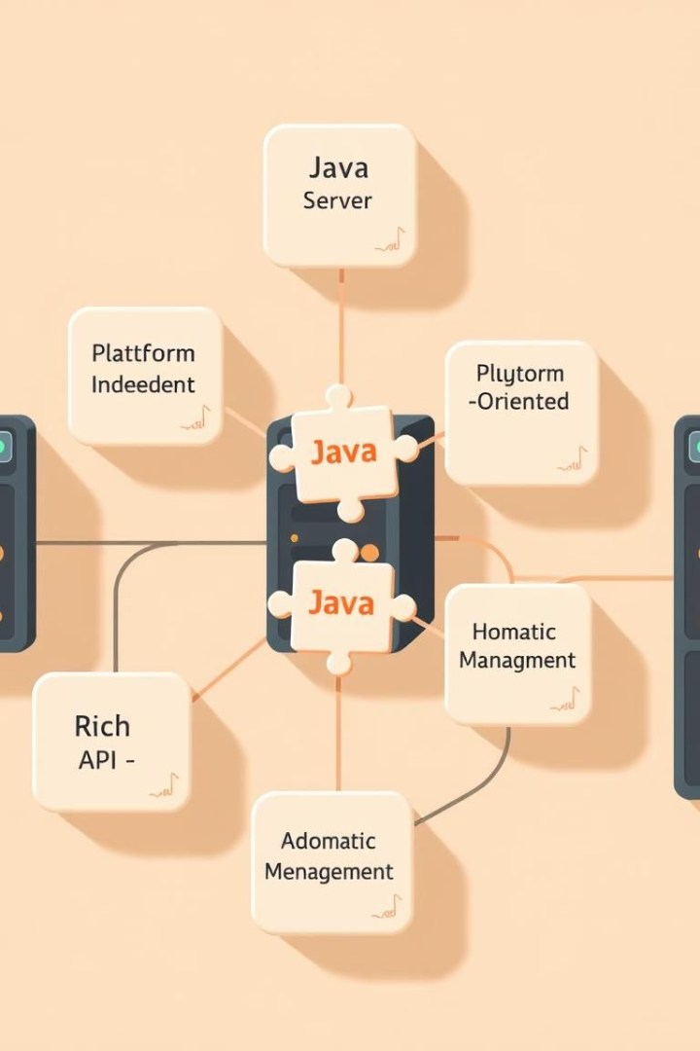
Advantages of Using Java
1
Platform Independence
"Write Once, Run Anywhere" (WORA)
2
Object-Oriented
Supports modularity and code reusability.
3
Large Community
Extensive libraries and frameworks.

Slide 9
IDEs for Java Development
IntelliJ IDEA
Eclipse
NetBeans
Advanced code completion and refactoring tools.
Versatile, open-source with strong Java support via plugins.
Integrated tools designed for Java development.

Slide 10

Conclusion
IDE Enhancement
Java Versatility
IDEs significantly enhance developer productivity.
Java's independence makes it a popular choice.
Efficient Environment
Combines Java with an IDE for productivity.

